Slide 1
REFLECTIONS On TEACHING COMPUTING
o. Univ.-Prof. DI Dr. Michael Schrefl
Institut für Wirtschaftsinformatik –
Data & Knowledge Engineering
Johannes Kepler University - Linz

Slide 2
STIMULI FOR This Talk:
Personal Experiences
Lack of essential skills and holistic knowledge by our graduates:
Repeated experiences of “double bookings” (e.g., train seats),
log protocols written a posteriori, naive use of analytics
Oral final exams: Students know details but lack an understanding of key essentials and cannot join the dots
Curriculum development:
Proposed curriculum development by work-place observation
Mismatch between education aims of the high school curriculum and teacher education as to Artificial Intelligence (AI)
Questions received on potentials and risks of AI

Slide 3
POTENTIAL CAUSES FOR LACK OF ESSENTIAL SKILLS AND MEASURES
POTENTIAL CAUSES | POSSIBLE MEASURES
Students skip lectures and comprehension-questions in exams (and still pass) | Knock-out questions (e.g., “give way rules” in Australian drivers licence tests)
Students copy (via Dopbox) and ride on colleagues coattails in group work | Individual exercise interviews and individual grading in group work (subtask responsibilities)
Students are distracted by details, have no clue about the underlying guiding principles and are not able to join the dots | Teaching by metaphors (e.g., S. Ceri: 2-phase commit & wedding-ceremony; M. Brockhaus: DB vs. PL vs. KR & warehouse manager vs. machinist vs. herb collector)
... | ...

Slide 4
Curriculum DEVELOPMENT
“Time-to-market“ (from curriculum design to first graduates):
Graduation (Bachelor/Master): after 5+ years
Working life of graduates: 35+ years
IT evolves in the meantime
Strategies:
Theory: Which fundamental concepts enable future graduates to quickly learn new models, approaches, and languages?
Foresight: What will be relevant in 5+ years?

Slide 5
Curriculum DEVELOPMENT
“Time-to-market“ (from curriculum design to first graduates):
Graduation (Bachelor/Master): after 5+ years
Working life of graduates: 35+ years
IT evolves in the meantime
Strategies:
Theory: Which fundamental concepts enable future graduates to quickly learn new models, approaches, and languages?
Foresight: What will be relevant in 5+ years?

Slide 6
Looking Back
Theory (TU/Uni Wien, 1980) | Relevance today (2019)
Logic | Revival of symbolic AI: Datalog, Vadalog, F-Logic, ASP, OWL
Automata, Petri Nets | Process Modelling: UML Statecharts, BPMN
Algorithms, Graph Theory | XML Processing, Graph Databases
Principles of Programming Lang. | Java, Python
... | ...
1980: Industrial Practice | 1980: Teaching (TU/Uni Wien)
IMS / Codasyl | Relational Databases, SQL (2018: “most thought after language skill”)
Design of file structures | Conceptual Modelling: Entity-Relationship Diagrams -> UML
... | ...

Slide 7
Looking Forward
Keep or Increase Theory Content!
Additional Fundamentals:
CACM Nov 2018: “How Machine Learning Effects the Undergraduate Curriculum”: Probability Theory and Statistics
CACM Mar 2019: Metamorphic Testing

Slide 8
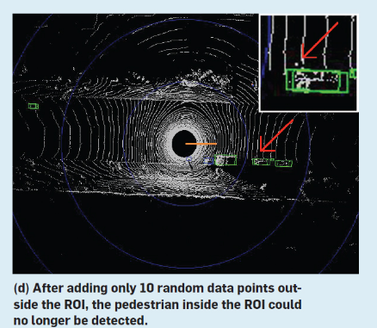

Ex.: OBSTACLE DETECTION BY Driverless Cars
“We detected fatal software faults in the LiDAR obstacle-perception module of self-driving cars and reported the alarming results eight days before Uber´s deadly crash in Tempe, AZ, in March 2018”
distributed
distributed
distributed
Z.Q. Zhou and L. Sun, Metamorphic testing of driverless cars", CACM 62 (3): 61-67 (2019)
ACM Copyright Notice: Permission to make digital or hard copies of part or all of this work for personal or classroom use is granted without fee provided that copies are not made or distributed for profit or commercial advantage and that copies bear this notice and full citation

Slide 9
Looking Forward
Keep or Increase Theory Content!
Additional Fundamentals:
CACM Nov 2018: “How Machine Learning Effects the Undergraduate Curriculum”: Probability Theory and Statistics
CACM Mar 2019: Metamorphic Testing
Foresight / Trends:
Rise of symbolic and non-symbolic AI
Importance of data semantics in analytics, system integration / migration
Procedural programming complemented by modelling / declarative programming
....

Slide 10


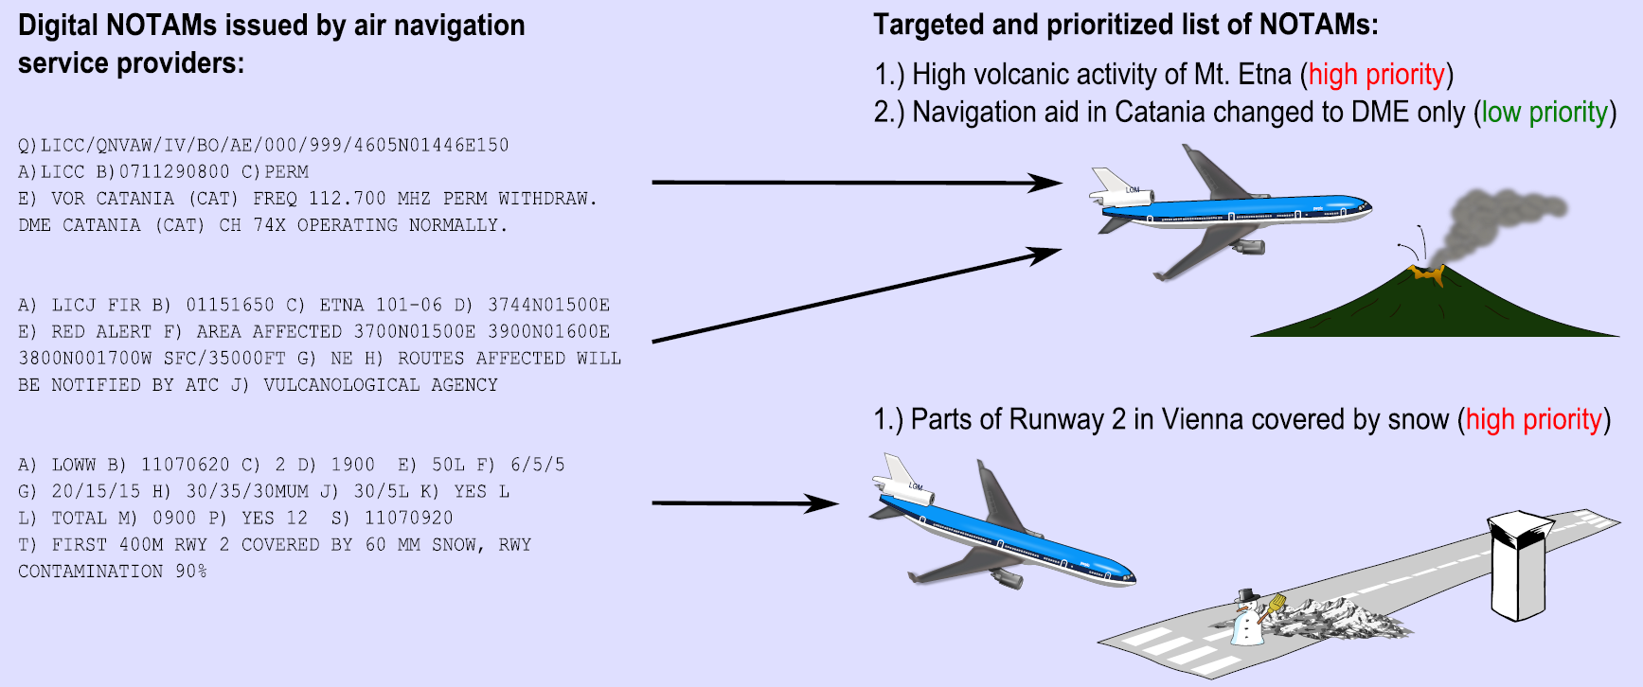

Ex.: Pilot Briefings
NoTICES TO AIRMEN (NOTAMS)

Slide 11
PILOT BRIEFINGS: NOW & THEN (SIMPLIFIED)
Now: Query-based
Then: Knowledge-based
EAD/FAA
NOTAM DB
EAD/FAA
DNOTAM DB
Flight plan
Flight plan
Parameterized database query (eg. SQL)
Aeronautical Knowledge
Reasoning Engine
Set Query Parameters
95% relevant
prioritized
summary
Targeted Pilot Briefing
10% relevant
not prioritized
no summary
Untargeted Pilot
Briefing
Results of projects: SemNotam (FFG TAKE-OFF),
BEST (EU HORIZON 2020)

Slide 12
Data Semantics:
SPEEDERs IN A AND D?
47 km/h
59 km/h
67 km/h
78 km/h
49 km/h
58 km/h
61 km/h
72 km/h
Road: Photo of
speed camera
(deleted)
Road: Photo of
speed camera
(deleted)
Road: Photo of
Austrian
place name sign
(deleted)
Road: Photo of
German
place name sign
(deleted)
Road: Photo of
70 km speed ´limit
(deleted)
Road: Photo of
70 km speed limit
(deleted)
Note: Photos
deleted as copy-
right not checked.
Austrian Road
German Road
Same street map data: But, place-name sign in Austria does not cancel speed-limit of 70, while place-name sign in Germany does!

Slide 13


Data Semantics:
SPEEDERs IN A AND D?
47 km/h
59 km/h
67 km/h
78 km/h
49 km/h
58 km/h
61 km/h
72 km/h
Photo of
speed camera
(deleted)
Photo of
speed camera
(deleted)
Photo of
Austrian
place name sign
(deleted)
Semantics:
A - StVO
§ 53(1)/17a,
§ 20 (2)
Photo of
German
place name sign
(deleted)
Semantics:
D - StVO
§ 3(3)/1,
Anlage 3 zu § 42(2)
Photo of
70 km speed ´limit
(deleted)
Photo of
70 km speed limit
(deleted)
Note: Photos
deleted as copy-
right not checked.
Austrian Road
German Road
Same street map data: But, place-name sign in Austria does not cancel speed-limit of 70, while place-name sign in Germany does!

Slide 14
The CASE FOR INCLUDING AI In TEACHER EDUCATION
Qualification profile, teacher education (example):
Graduates should be able to present the importance and relevance of computing in the different areas of life
And to explain differences and relationships between subfields of computing based on knowledge of their methods
Artificial Intelligence (AI):
AI is penetrating all areas of live (e.g., Google Car, Siri, Alexa, computer games, robots, personality profiling, surveillance)
Methods and techniques of AI (heuristic search, knowledge representation and reasoning, machine learning) are fundamentally different from conventional programming and traditional information systems

Slide 15
ACM K-12 (HIGH SCHOOL)
Model CURriculum
ACM K-12 Model Curriculum:
AI is part of high-school model curriculum since 2003
“Computer Science in a Modern World: ... models of intelligent behaviour (as found in robot motion, speech and language understanding, and computer vision) and what distinguishes humans from machines”.
ACM K-12 as to teacher education:
“... teachers must have a greater depth of knowledge than that embodied in the topics they are teaching .... “

Slide 16
AHS LEHRPLAN Informatik
Education and Teaching Aims:
“Einblicke in wesentliche Begriffe und Methoden der Informatik”
SchülerInnen “erkennen das Potential ihrer eigenen Fähigkeiten als denkende, handelnde, fühlende und sich entwickelnde Menschen im Unterschied zu einer lernenden Maschine”
Didactic Principles:
“... vielfältige Bezüge zur Lebens- und Begriffswelt der Jugendlichen herstellen”
Learning Outcomes:
“Unterschied zwischen menschlicher und maschineller Intelligenz erklären können”
“Intelligente Informationsysteme anwenden können”

Slide 17
LEHRAMT INF: PFLICHTFACH
“INTRODUCTION TO AI”
Why?
For years, high school teachers in computing were not trained adequately for their job and lacked relevant skills
Teachers are educated for teaching from in 5 years for 30+ years
AI will penetrate all areas of life and teachers should be capable to engage with their students in well grounded discussions on AI
Learning outcomes:
Understand the difference between conventional IT systems and symbolic / model-based and sub-symbolic / function-based techniques of AI
Ability to explain the approach of AI, in particular the turning away from the principle of provability and, hence, the reliable correctness of computer decisions

Slide 18
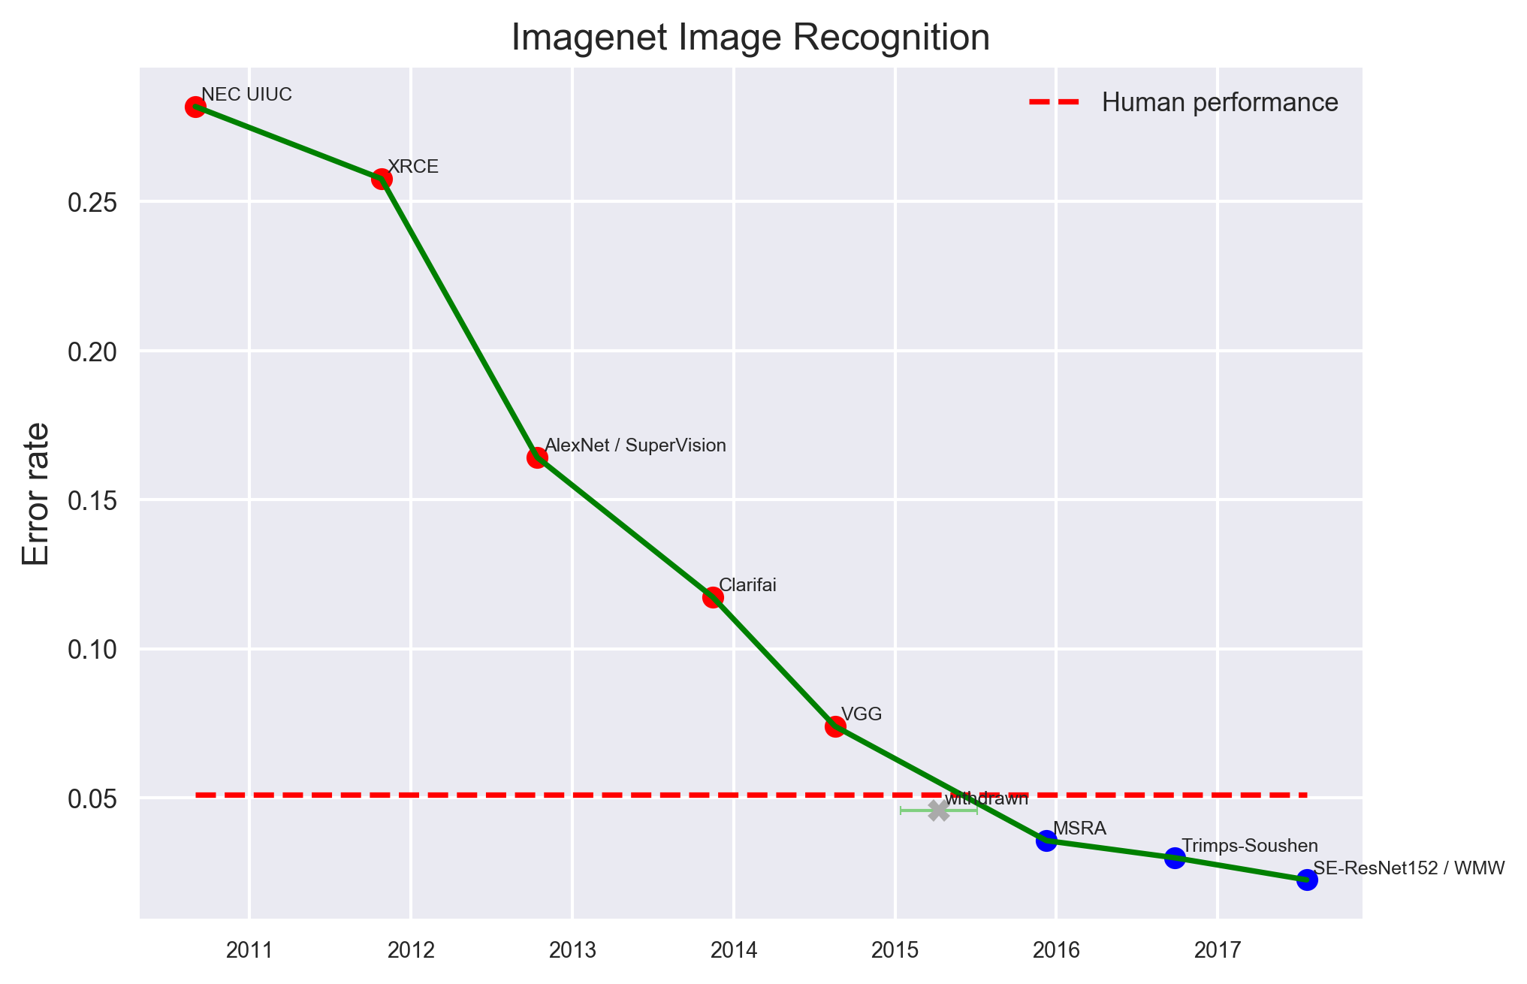
AI PROGRESS MEASUREMENT:
IMAGE ReCOGNITION
EFF. (2018). AI progress measurement. https://www.eff.org/de/ai/metrics.

Slide 19
preventive Imprisonment: IS USE of AI A GOod IdeA?
Automated Inference on Criminality using Face Images (Wu, Zhang; Shanghai 2017)
Neural network classifier:
C ...Criminal, N .. Not criminal
Accuracy = 89,51 % (number of testing samples correctly classified)
What is the chance that someone who is classified as criminal is actually a criminal P(C|+)? 89,51%?

Slide 20
INTERPRETING RESULTS:
TRAINING OF NEURAL NET
Automated Inference on Criminality using Face Images (Wu, Zhang; Shanghai 2017)
Neural network classifier:
C ...Criminal, N .. Not criminal
Accuracy = 89,51 % (number of testing samples correctly classified)
What is the chance that someone who is classified as criminal is actually a criminal P(C|+)? 89,51%?
We need to ask:
Proper training of neural net:
- White collar vs face?
- Trained on European faces?

Slide 21
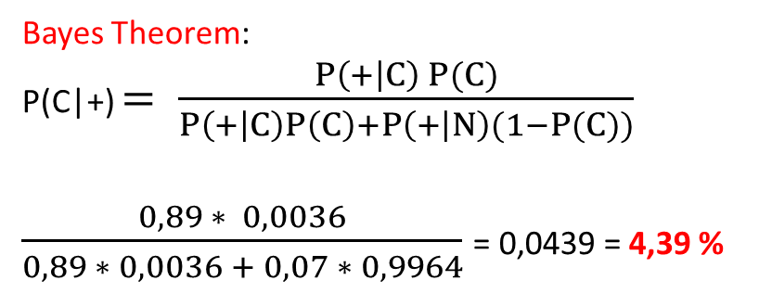
INTERPRETING RESULTS:
BASE RATE FALLACY
Automated Inference on Criminality using Face Images (Wu, Zhang; Shanghai 2017)
Neural network classifier:
C ...Criminal, N .. Not criminal
Accuracy = 89,51 % (number of testing samples correctly classified)
What is the chance that someone who is classified as criminal is actually a criminal P(C|+)? 89,51%?
Bayes Theorem:
P(C|+) $= \frac{P\left(+ | C\right) P(C)}{P\left(+ | C\right)P\left(C\right)+P\left(+ | N\right)(1−P(C))}$
$\frac{0,89 ∗ 0,0036}{0,89 ∗ 0,0036 + 0,07 ∗ 0,9964}$ = 0,0439 = 4,39 %
We need to consider:
Base rate P(C) = 0,0036
(crime rate in China)
True positive rate P(+|C) = 0,89
False positive rate P(+|N) = 0,07
AHS-Lehrplan Mathematik (2018), 6. Klasse:
“Den Satz von Bayes kennen und anwenden können”

Slide 22
ILLUSTRATION:
BASE RATE FALLACY
True Negative
False Negative
False Positive
True Positive
Criminal
Not criminal

Slide 23

Google Translate:
THE Effect of STATISTICS
Google uses sub-symbolic AI methods, based on statistics: There are more female teachers and more male professors in texts analysed.

Slide 24
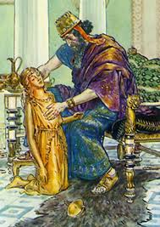



Stuart RUSSEL: AI and the KING MIDAS PROBLEM
Painting by: Charles
Edmund
Brook
(1870-1938)
Hollywood scenarios in which robots set their own objectives seem to be unrealistic ...
... but we may unwisely set robots objectives they pursue brilliantly to the destruction of mankind.
Reference: Stuart Russel, UCLA Berkeley, at World Economic Forum 2016.
https://futureoflife.org/2016/12/12/artificial-intelligence-king-midas-problem/

Slide 25
Endorsements:
AI IM LEHRAMT INFORMATIK
List: AI_Lehramt_Informatik
Date: 2020-05-29 19:05:00
Link: https://www.yourlist.de/?code=9KQRpy6

